Slide 1


Social Buzz

Slide 2


Today's agenda
Project recap
Problem
The Analytics team
Process
Insights
Summary

Slide 3

Social Buzz is a social media company that emphasizes content by keeping all users anonymous, only tracking user reactions on every piece of content.
To start our engagement with Social Buzz, we are running a 3 month initial project in order to prove to them that we are the best firm to work with.They are expecting the following:
- An audit of their big data practice
- Recommendations for a successful IPO
- An analysis of their content categories that highlights the top 5 categories with the largest aggregate popularity
Project Recap

Slide 4


Problem
An analysis of Social Buzz content categories that highlights the top 5 categories with the largest aggregate popularity

Slide 5
Chief Technology Architect
Andrew Fleming
The Analytics team
Senior Principal
Marcus Rompton
Data Analyst
Quadri Naheem

Slide 6
Process
1 Load the datasets
2 Clean and merge the datasets
3 Perform univariate analyses
4 Do bivariate analyses
5 Conclusion

Slide 7
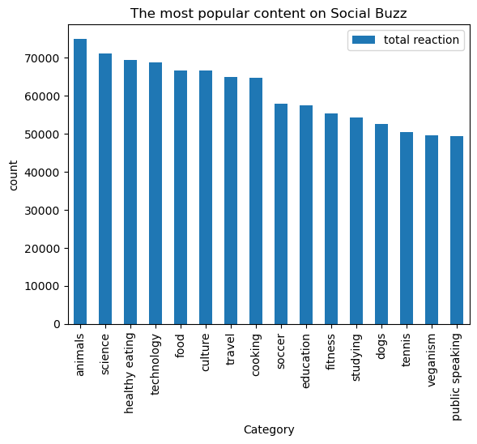
Insights

Slide 8
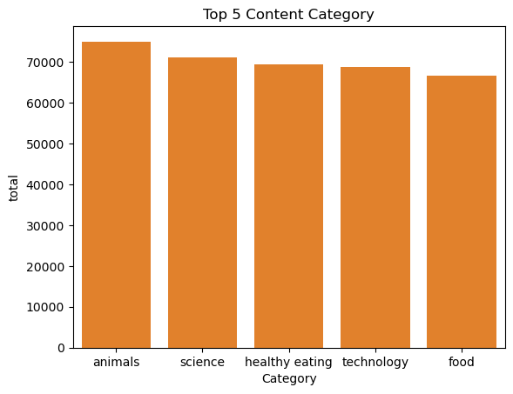


Slide 9

Thank you!
ANY QUESTIONS?

